Slide 1
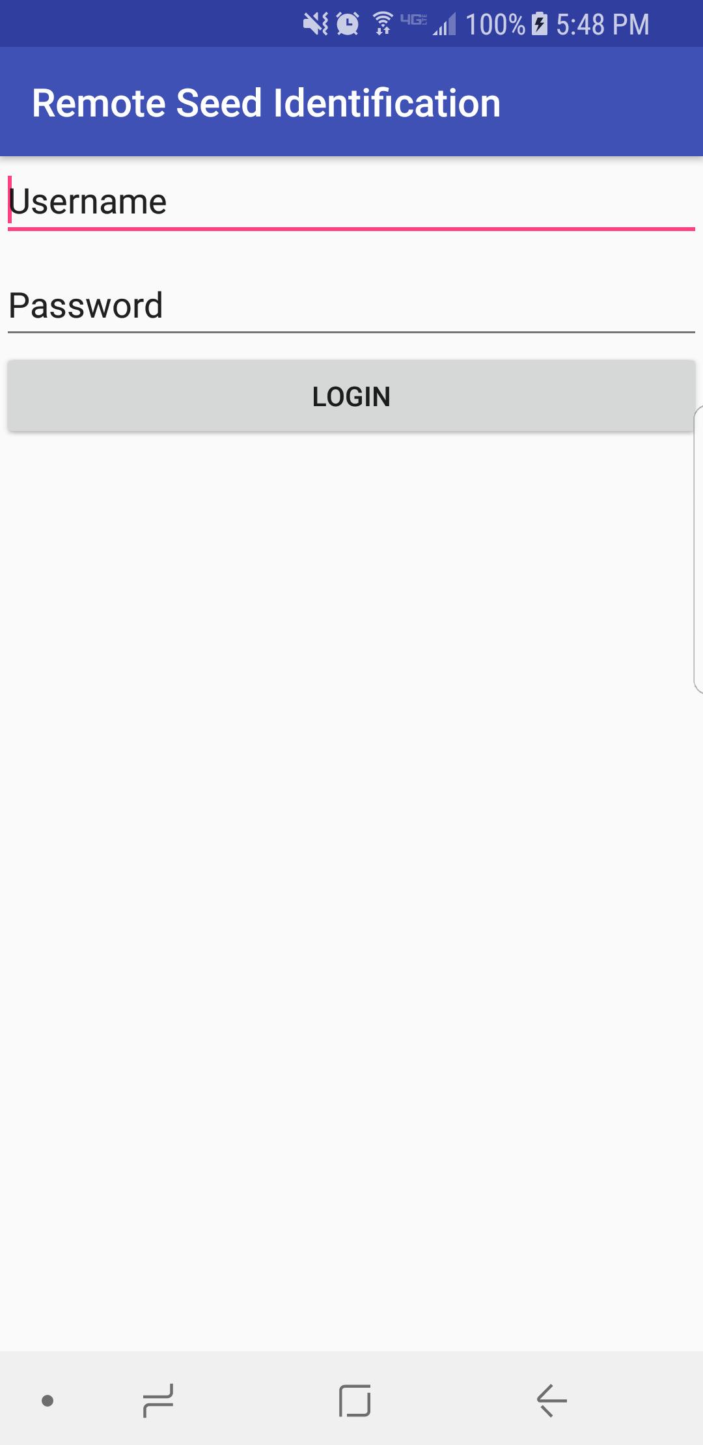
Login Activity
First activity on launch
Skeleton activity at the moment
Plans to add a button for registration

Slide 2
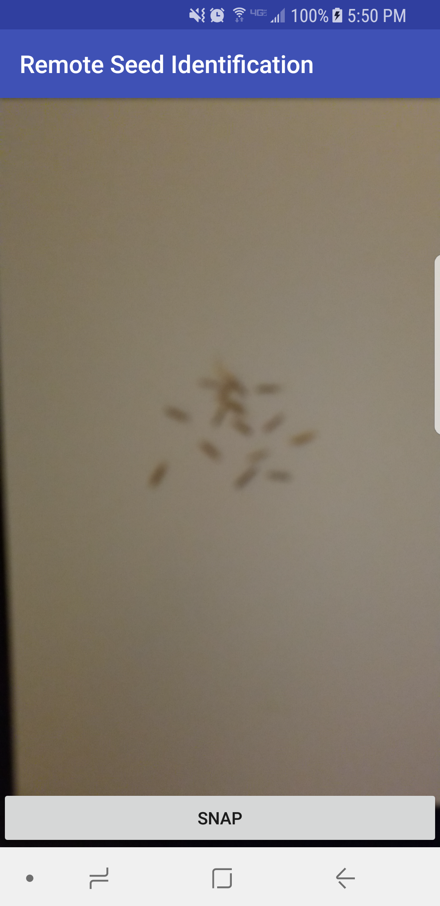
Main Activity
Central activity of the app
No autofocus yet
Slide out navigation drawer

Slide 3
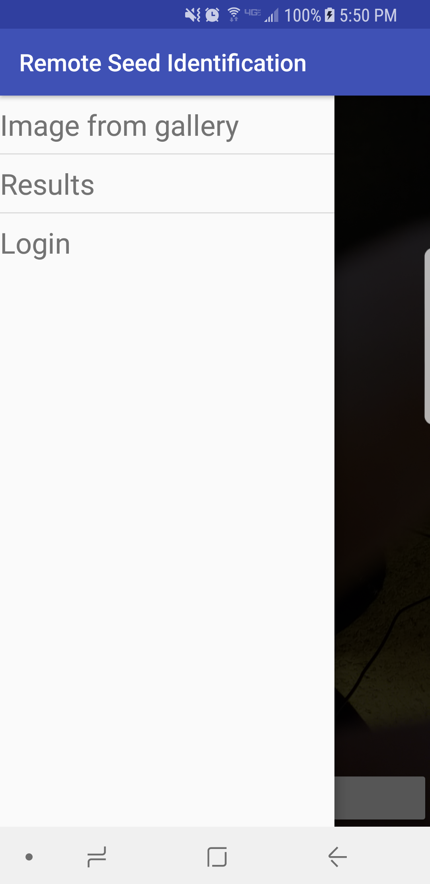
Navigation Drawer
Select images from phone’s gallery
Navigate to results activity
Return to login activity

Slide 4
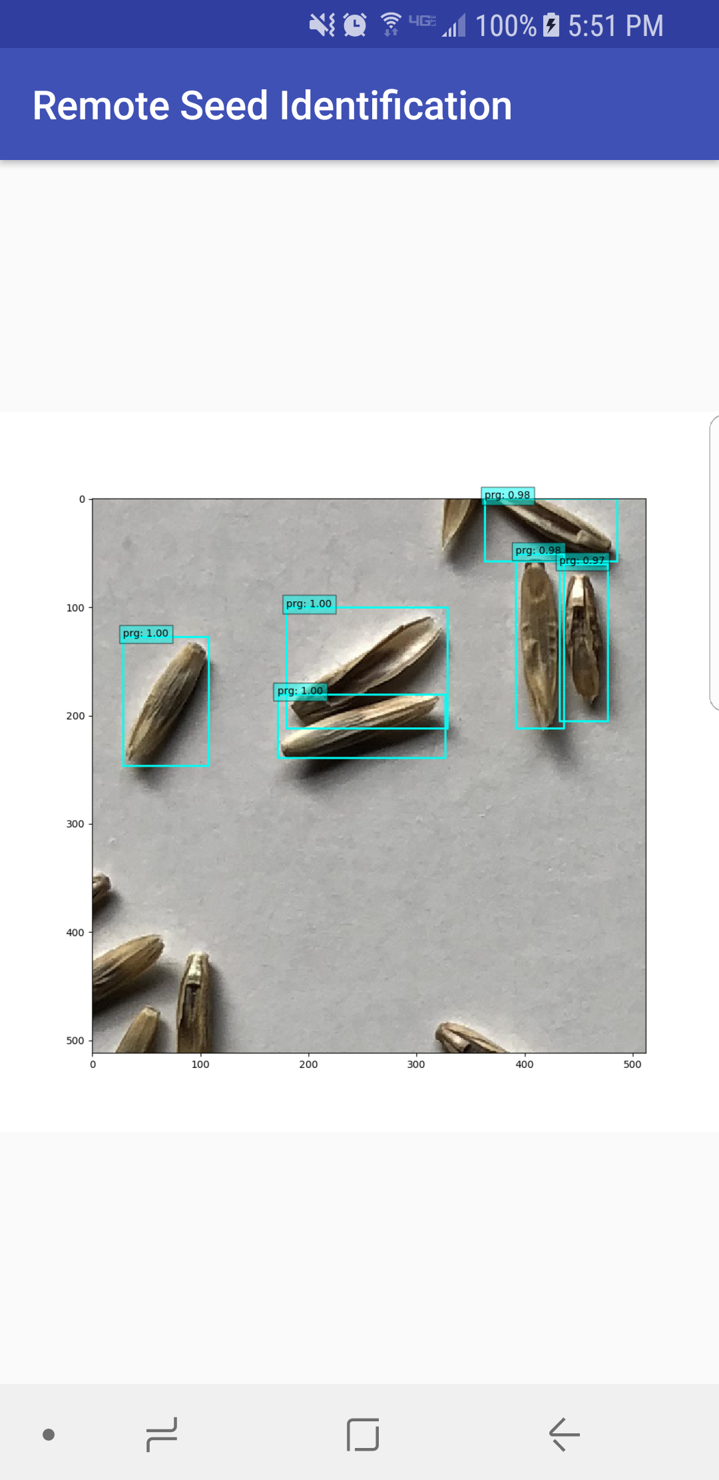
Results Activity
Placeholder image
List of user’s results
Final image similar to one shown here

Slide 5
Issues
Getting started
Camera display
Layout manager inconsistencies

Slide 6
What is left to do
Establish connection with server
Flesh out results activity
Registration activity
Help
Beautify

